Slide 1

IMT 577 Final Project
Store Sales Analysis: Store 5 vs. Store 8
Chesie Yu, Jaivardhan Chauhan, Varun Bathija

Slide 2




Table of Contents
01
02
03
04
Performance
Assessment
Bonus Allocation
Weekly
Product Sales
Store by State Analysis

Slide 3
01
Performance Assessment
How are they performing compared to target?
Will they meet their 2014 target?
Should either store be closed? Why or why not?
What should be done in the next year to maximize store profits?

Slide 4
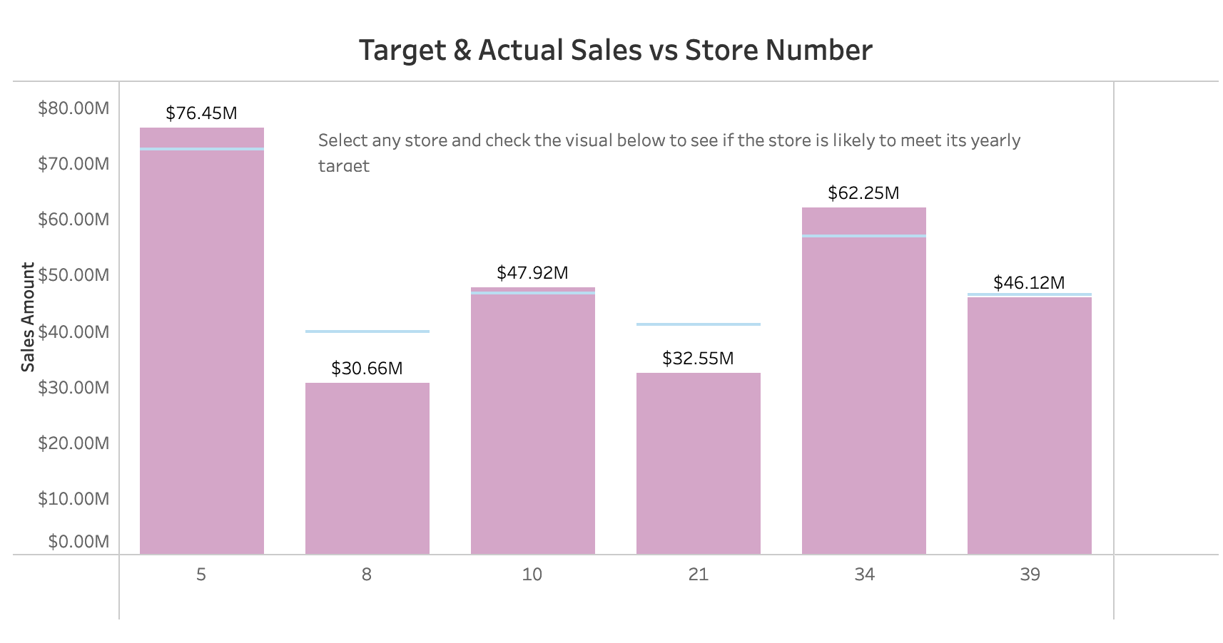
Performance in 2013

Slide 5
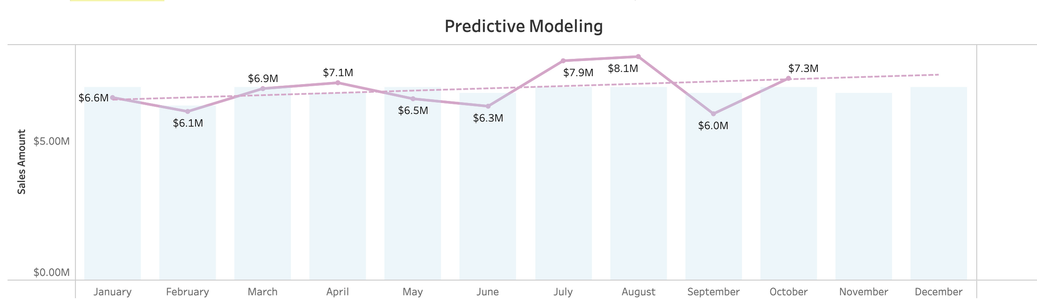
Will the Store meet its target in 2014?
Above visualization is for Store 5.
We predict both Store 5 and 8 will meet their 2014 targets.
Store 5 is estimated to achieve $83.45 million, overachieving by 1.77%
Store 8 is expected to hit $36.36 million, exceeding annual target by 9.35%

Slide 6
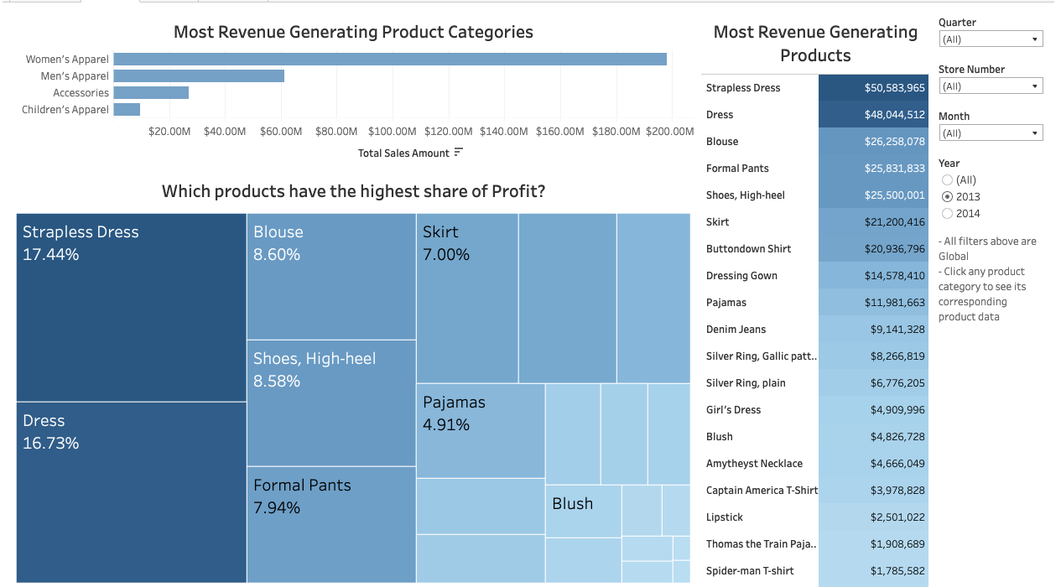
How to maximize profits?
I
Upselling and cross selling during peek days
Expansion of most profitable product lines and variants
Encourage repeat purchases by implementing loyalty programs

Slide 7
02
Bonus
Allocation
Recommend separate 2013 (bonus pool: $500,000) and 2014 (bonus pool: $400,000) bonus amounts for each store.

Slide 8
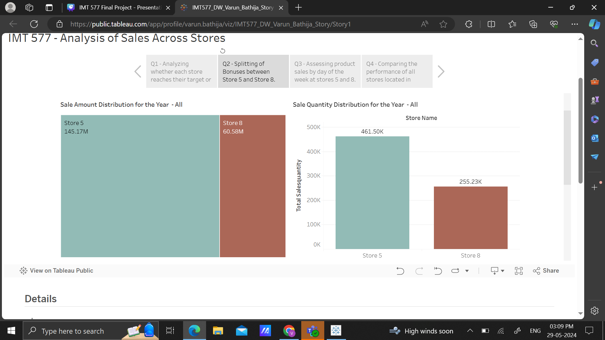
Comparing the Sale Amount and Sale Quantity for Store 5 and Store 8?
From the above visualization we can see that the Total SalesAmount for Store 5 (145 Million)is more than double than that of Store 8 (60 Million). We have also compared the Sale Quantity for each store.
In order to get the views for these visualizations I pulled store data and sale data from the respective fact and dimension tables and grouped them by year and store number.

Slide 9
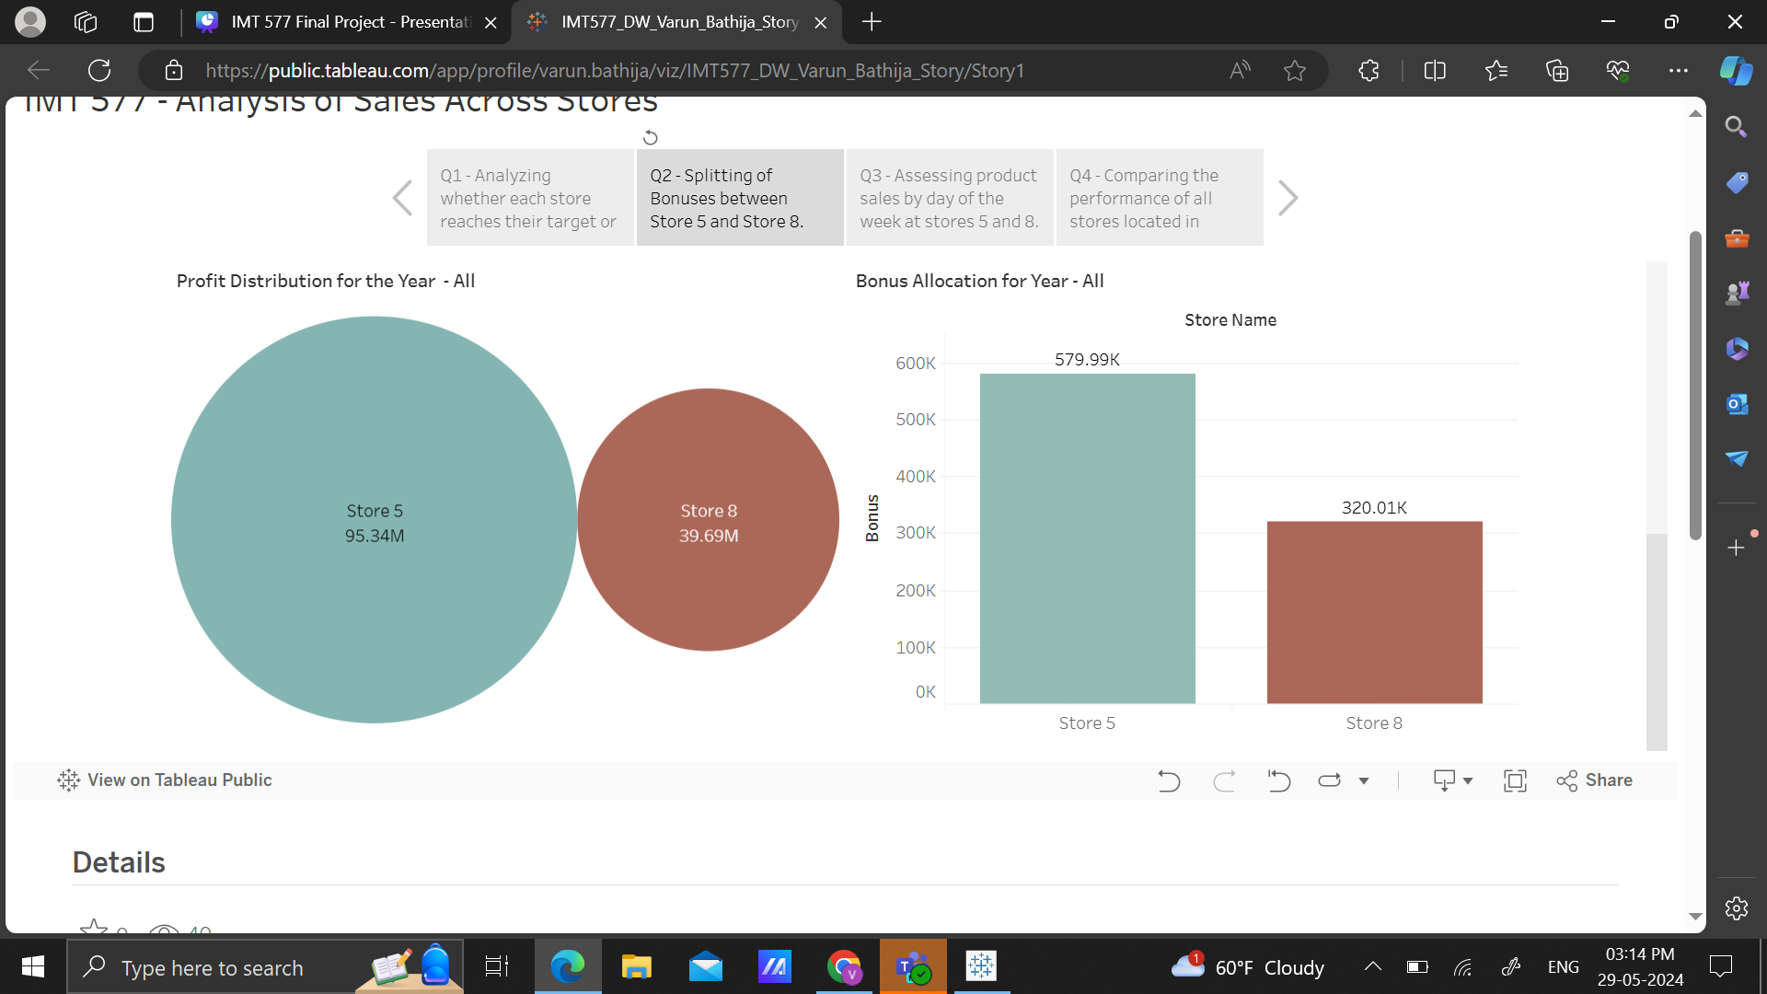
Comparing the Profit Distribution and allocating Bonuses for Store 5 and Store 8
The above visualization compares the Profit Distribution between the 2 stores. Based on the Sale Target Quantity, Sale Amount and Total Profit I have calculated and assigned Bonuses for both the stores in Snowflake Views.
I used the individual bonuses for each year and based on the proportions of amount, quantity and profit for each year you can filter out to calculate either per year bonus or total bonus assigned.

Slide 10
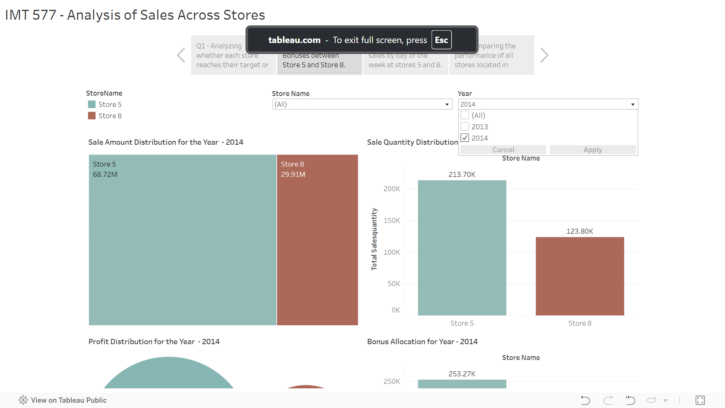
Dashboard Screenshots showing Filters

Slide 11
03
Weekly
Product Sales
Assess product sales by day of the week at Stores 5 and 8. What can we learn about sales trends?

Slide 12
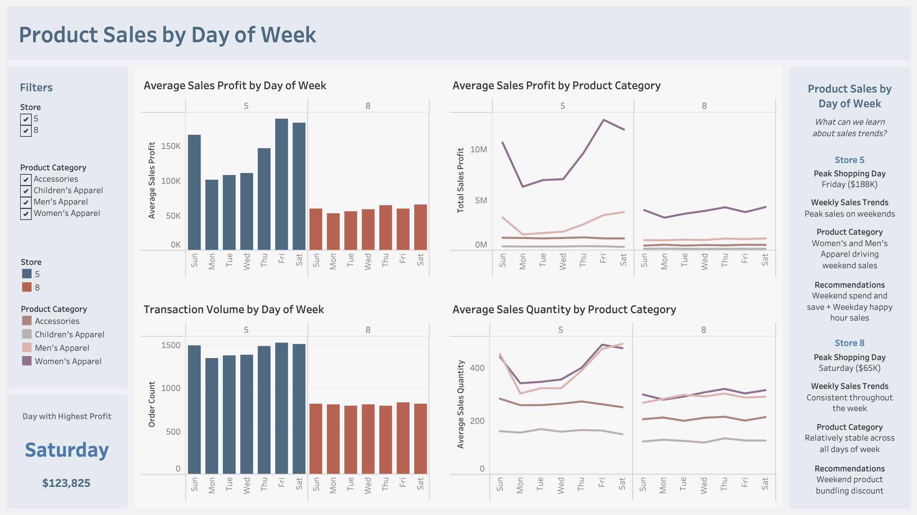

Slide 13
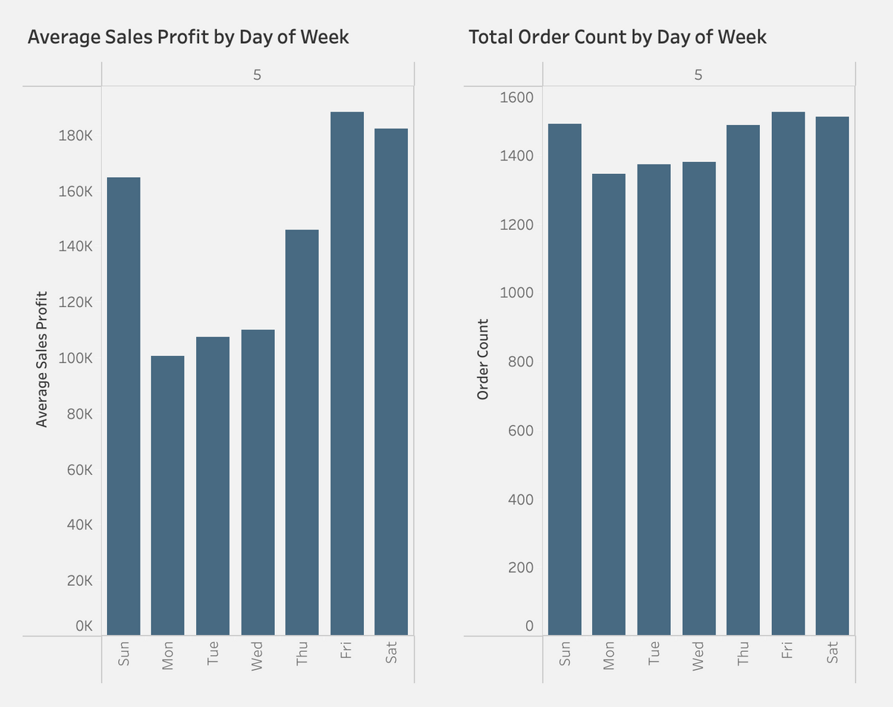

Store 5
Weekly Sales Trend
Peak Profit Days:
Friday ($188K)
Saturday ($182K)
Aligns with consumer behavior
Lowest Profit Day:
Monday ($100K)
Post-weekend drop-off
Transaction Volume:
Similar trends but not as drastic
Lower average transaction values on workdays!

Slide 14
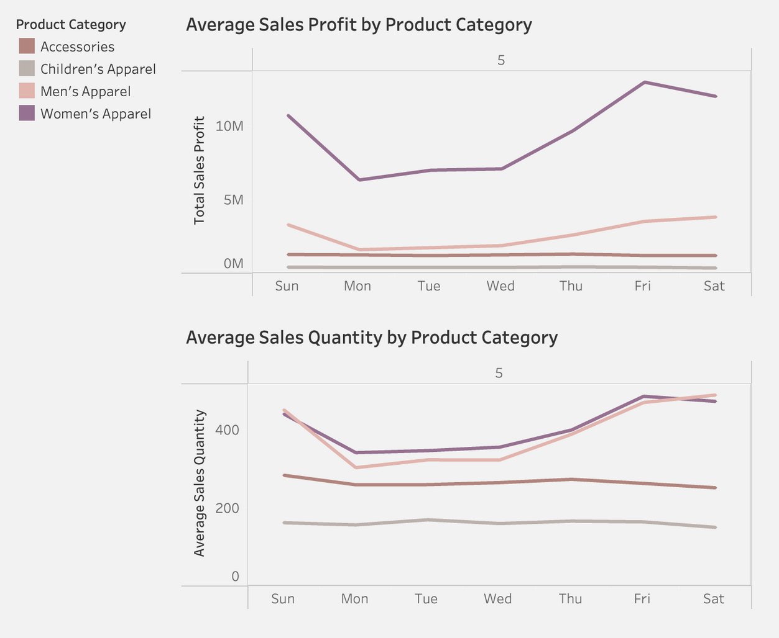

Store 5
Product Category
Most Popular Categories:
Women’s Apparel
Men’s Apparel
Weekly Sales Trends:
Women’s Apparel and Men’s Apparel drives weekend sales
Customers tend to purchase more high-margin products during weekends!

Slide 15
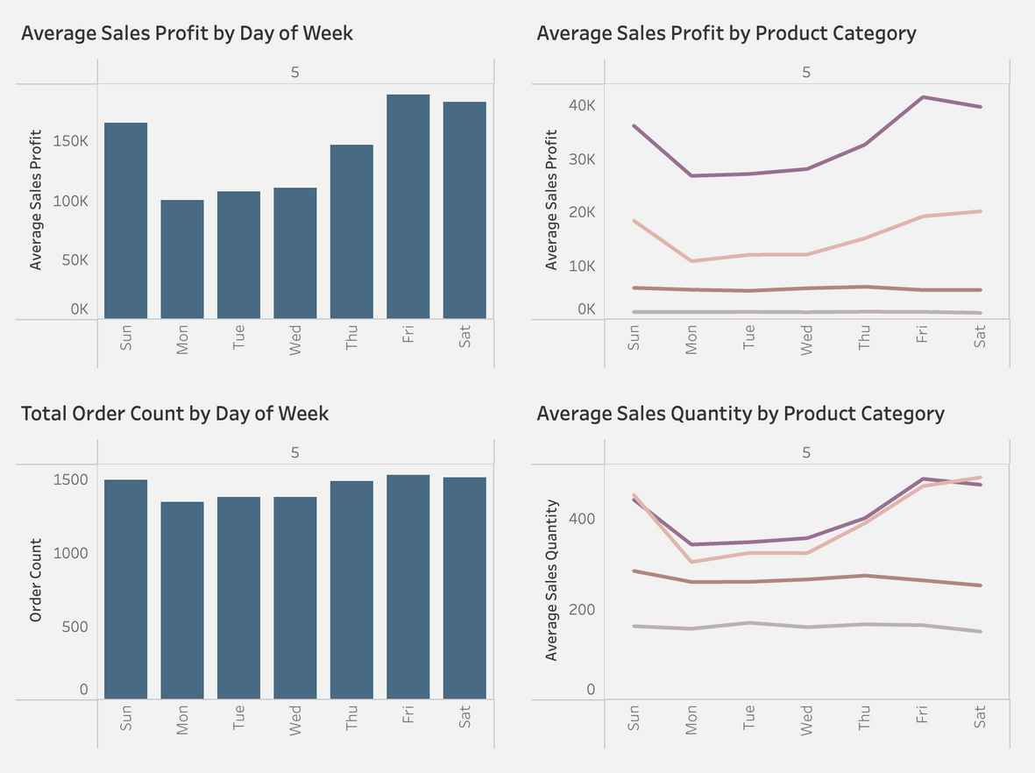




Store 5
Recommendations
Focus Promotional Efforts on Women’s Apparel and Men’s Apparel
Weekend Promotions: Spend and Save
Weekday Promotions: Happy Hour Sales

Slide 16
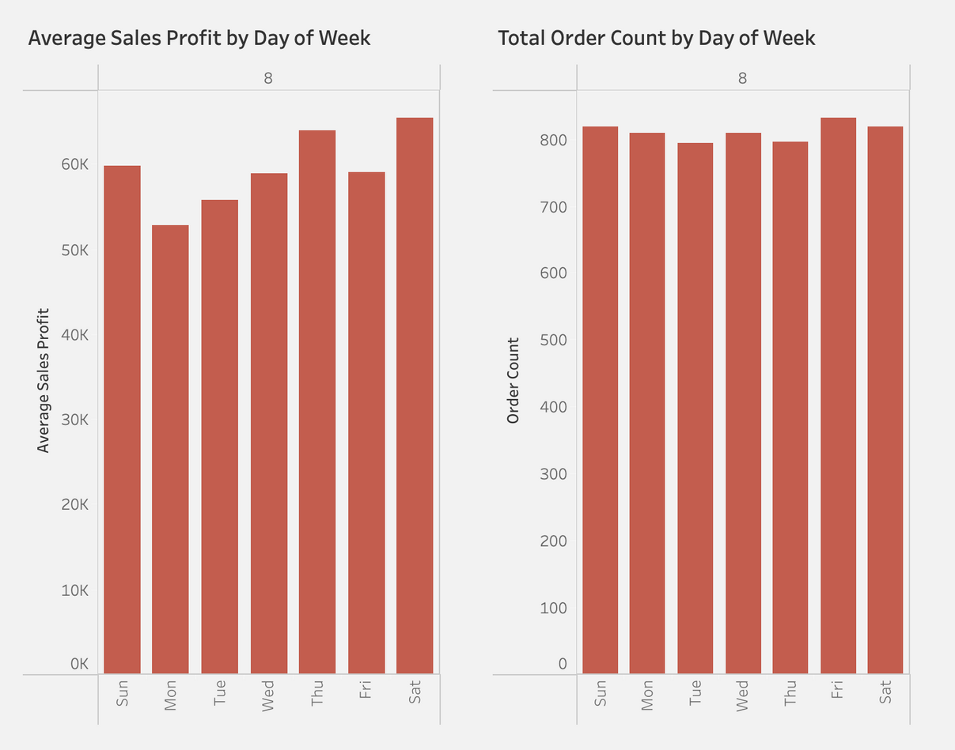
Store 8
Weekly Sales Trend
Peak Profit Days:
Saturday ($65K)
Thursday ($64K)
Slightly higher during weekends
Lowest Profit Day:
Monday ($53K)
Post-weekend drop-off
Transaction Volume:
Consistent throughout the week
Opportunity: Weekend Sales

Slide 17
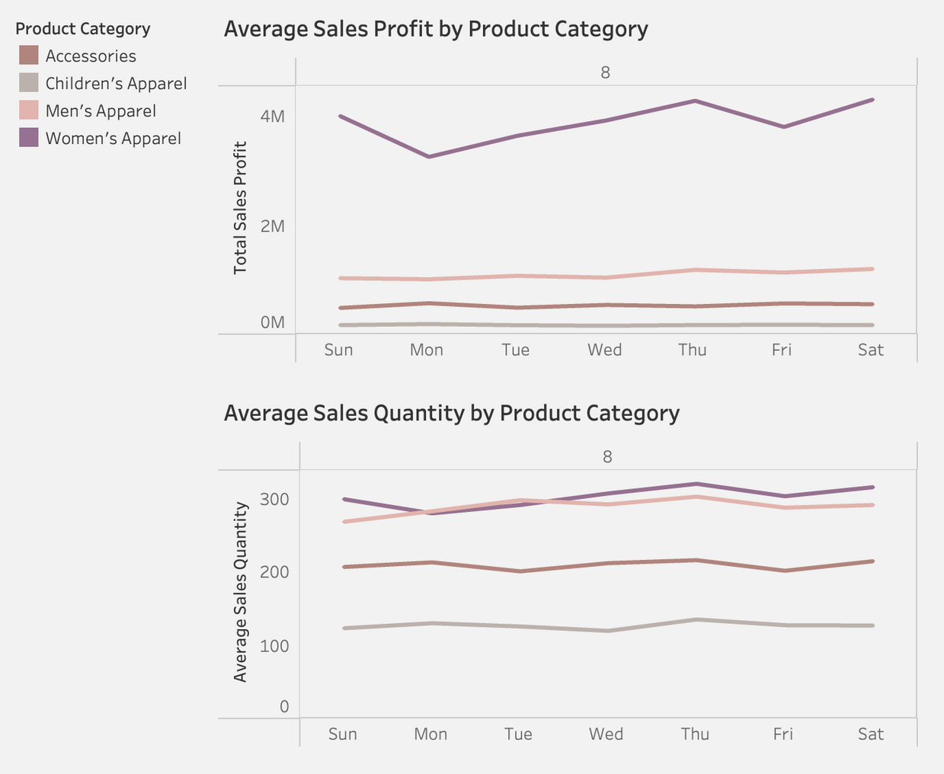
Store 8
Product Category
Most Profitable Categories:
Women’s Apparel
Men’s Apparel
Weekly Sales Trends:
Relatively stable across the week for all categories
Opportunity:
There is room to maximize profit from high-margin items!

Slide 18
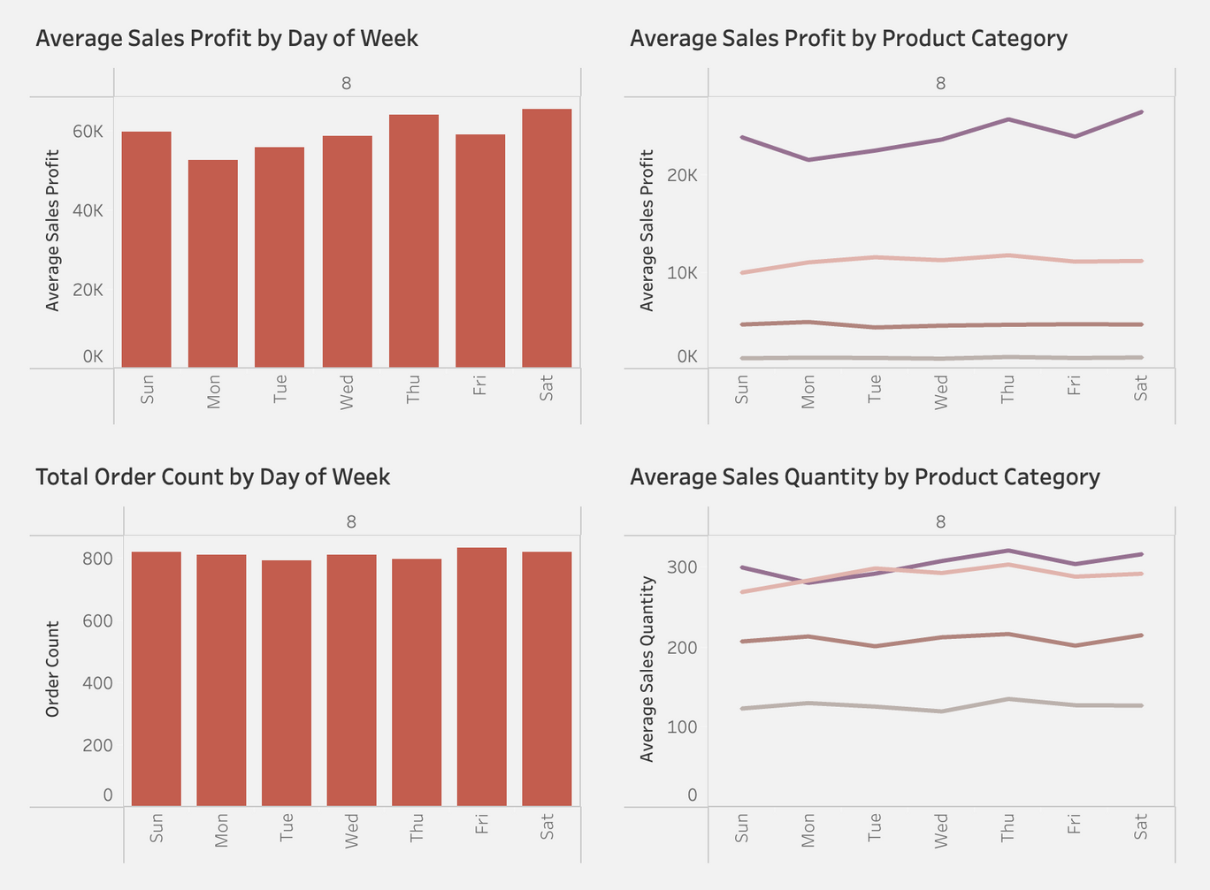
Store 8
Recommendations
Focus on higher-margin products during peak shopping days
Weekend Promotions
Upselling
Product Bundling Discounts
e.g., Buy 2 for 20% off, buy 3 for 30% off
Increase transaction values

Slide 19
04
Single-Store vs Multi-Store States
What can we learn about having more than one store in a state?

Slide 20
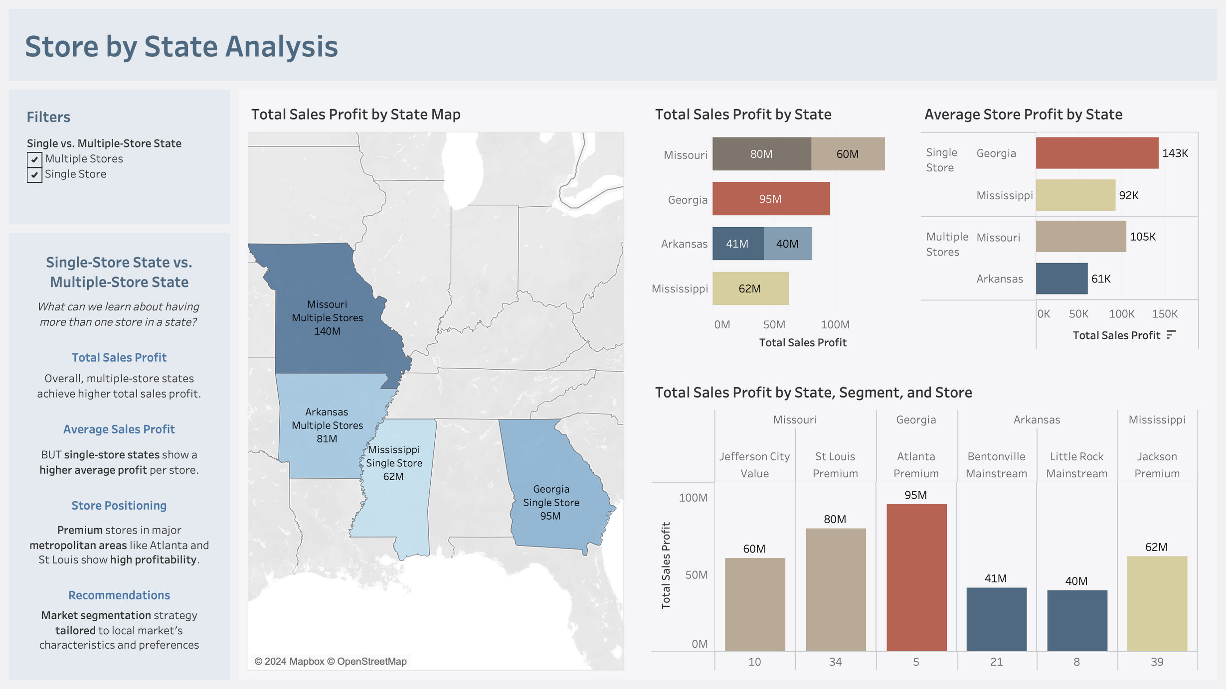

Slide 21
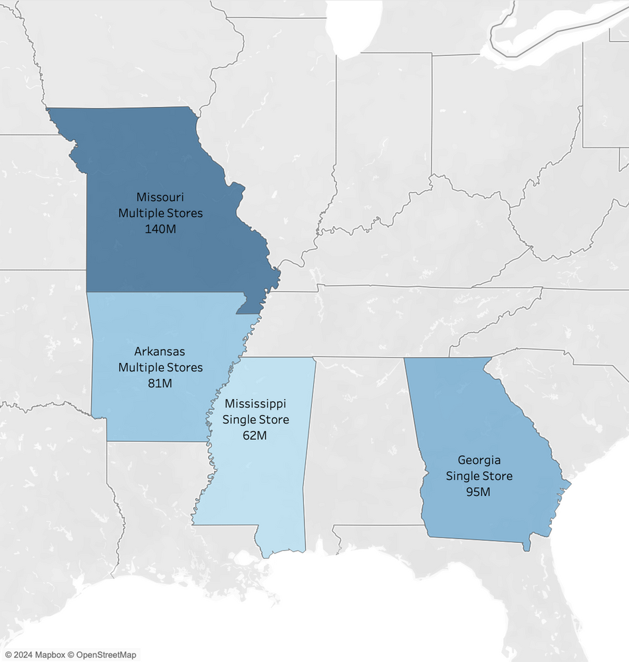

Store Location
Location Overview
6 Stores in 4 States:
Multi-Store States: Missouri, Arkansas
Single-Store States: Mississippi, Georgia
Sales Performance:
Metric: Sales Profit
States with multiple stores show higher total sales profit
Economies of Scale -> Increased Total Profit

Slide 22
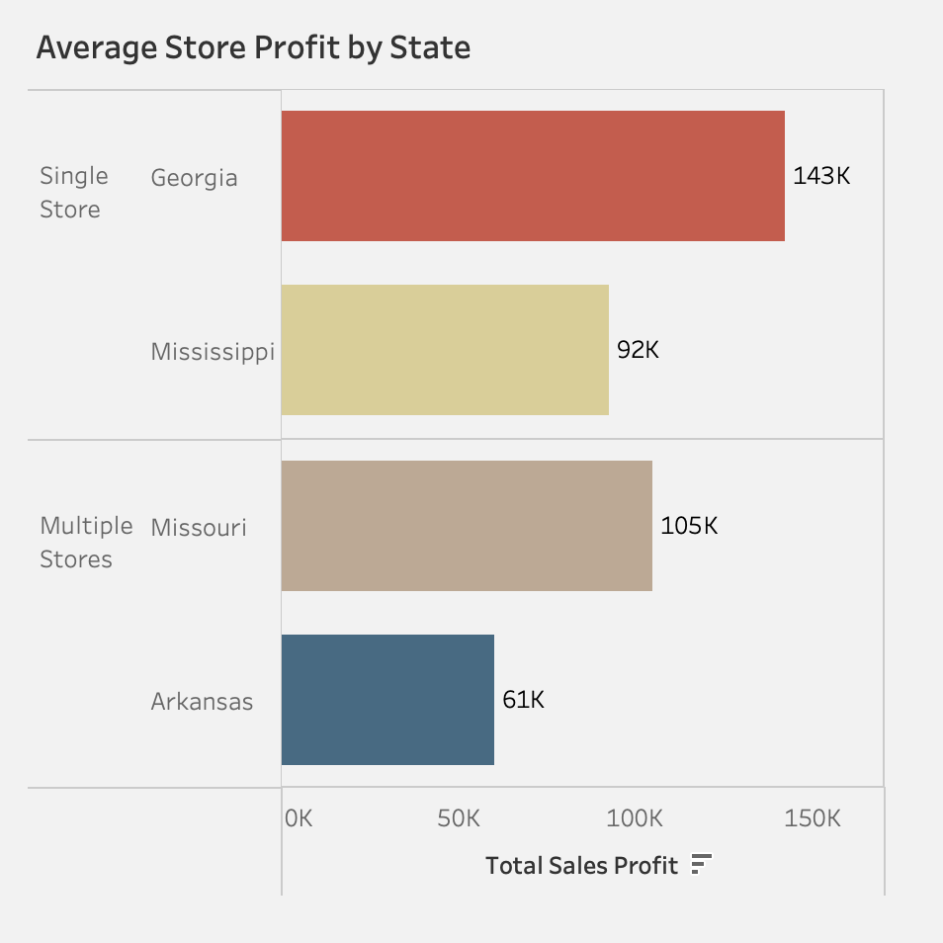

Store Location
Average Profit
Single-store states outperform in average store profit.
Highest Profit:
Georgia ($143K)
Single-Store State
Lowest Profit:
Arkansas ($62K)
Multiple-Store State
Diluted Profitability!

Slide 23
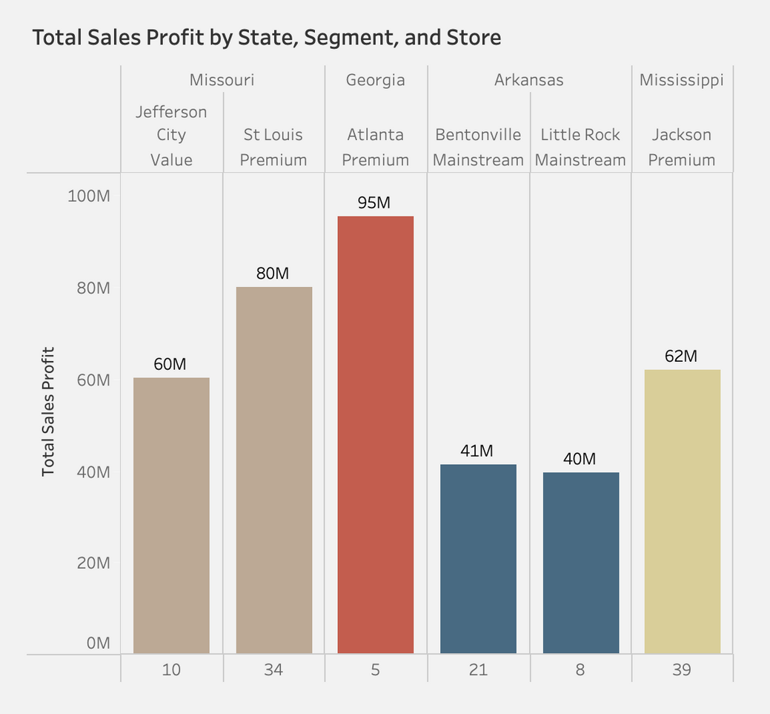
Store Location
Location Strategy
Store Positioning:
Premium stores in major metropolitan areas like Atlanta and St Louis show high profitability.
Recommendations:
Market segmentation strategy tailored to local market's characteristics and preferences.

Slide 24
THANK YOU!

